Slide 1
Git & Github Workshop
Looking Under the Hood

Slide 2
Folder vs. Directory vs. Repository
Folder
Folder on your computer to store files under a single name.
More user friendly name for a directory.
Directory
Folder on your computer to store files under a single name.
Stems from the organizational system of the filesystem, allowing files to be more easily findable
Repository
git workspace
Where a git project is located, can be identified because the root of the repo contains a .git folder where all the git data is stored.
Folder = Directory != Repository

Slide 3
Git & Github Differences
Git
Runs on your local machine
Version Control
Workspace
Github
Public facing UI to manage your repo
Remote Repository
Portfolio

Slide 4
Git - Looking Under the Hood: Basic Commands
git init
git clone <remote-repo-url>
git add <file-name> or git add .
git commit -m “Commit Message Required”
git push
git pull

Slide 5
Git - Looking Under the Hood: Basic Workflow
Create Git Repository
Create and develop code
Stage Code
Commit Code
Push Code
Pull Code

Slide 6
Git - Looking Under the Hood: Basic Workflow
Create Git Repository
Create and develop code
This is the part where you connect any regular folder on your computer to git.
Use: ls -la on bash or ls on powershell
Initializing a starting point for your version control history as you develop your code.
Initializing your code’s connection to the world wide web through remote repos

Slide 7
Local Repo vs. Remote Repo
After making changes to a file
Local Repo
A local repository is on that exists on the machine you are currently working on.
A local repo can be made using either git init or if it already exists you can get it on your local machine using git clone <remote-repo-url>
Remote Repo
A remote repository is one that exists hosted on a server; ie. github, bitbucket or gitlab.

Slide 8
Staged vs. Unstaged
After making changes to a file
Unstaged
Before applying
git add . or git add <file–name>
Those changes are unstaged; won’t be part of your next commit
Use .gitignore to specify files or folders to never add. (note if the file has already been committed then adding it to the .gitignore file will not stop tracking it).
Staged
After applying
git add . or git add <file-name>
Those changes become staged; will be part of your next commit.

Slide 9
Git - Looking Under the Hood: Basic Workflow
Commit Code
Think of this as creating a record for the set of changes you’ve added to your git repository.
(ls -la or dir /a or ls -Force to look at hidden .git folder)
When using commit, your saving this record locally on your machine. This record is what’s used to reference every update you’ve made when developing your code over time.
(.git folder holds the record of all your commits)
You should try to only commit working code whenever possible.
Us the command below to look at your history of changes
git log

Slide 10
Git - Looking Under the Hood: Basic Workflow
Push Code
This is where you send all the commits you’ve made to a remote repository, like github, bitbucket or gitlab.
Now you can access those changes from any computer with an internet connection and git to continue developing from anywhere in the world.
Now you can collaborate with other developers on a single project.
Now you can showcase your work to the rest of the world, and give them a picture of where you currently find yourself as a developer and the path your taking.

Slide 11
Git - Looking Under the Hood: Basic Workflow
Pull Code
With this command you can now pull any changes you’ve made to your git repository from anywhere you’ve established a connection to it.

Slide 12
Git - Looking Under the Hood: Basic Commands
git init or git clone <remote-repo-url>
git init
Starts a git repository locally on your machine.
Lets you start a git repository locally on your machine to at a later time be pushed to a remote repository for more flexibility in access.
git clone <remote-repo-url>
Clones an already made repository from a remote location
Lets you copy code over from a remote repo of your choice; ie. github, bitbucket, gitlabs.

Slide 13
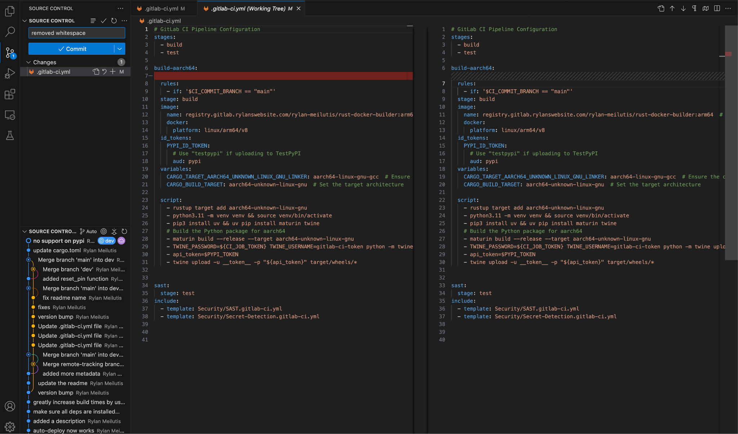
IDE Integration: Vscode / Code Composer Studio
Stage a file

Slide 14
IDE Integration: Vscode / Code Composer Studio
Discard changes

Slide 15
IDE Integration: Vscode / Code Composer Studio
Commit and Commit and push button Above that is the commit message box

Slide 16
IDE Integration: Vscode / Code Composer Studio
Staging area, this will show staged and unstaged files, clicking on a file will bring up a diff to show what has changed

Slide 17
IDE Integration: Vscode / Code Composer Studio
Git diff (from earlier)

Slide 18
IDE Integration: Vscode / Code Composer Studio
Source tree, this shows commits, merges, branches, tags and more.

Slide 19
End of Presentation
Thank you for your time.

Slide 20
Git - Looking Under the Hood: Intermediate Commands
Merging
Branching
Stashing

Slide 21
Git - Looking Under the Hood: Common Issues
Divergent Branches
Local Branch Behind Main Branch
Merge Conflicts
Rebasing Conflicts

Slide 22
Git - Looking Under the Hood: Common Issues
Local Branch Behind Main Branch
git pull origin
Observe what files are producing conflict
Correct conflict by matching files in workspace with files in remote branch
git add <file-name>
Staging files without conflict puts you one step closer to resolving conflict
git push origin
Overcome conflict

Slide 23
Git - Looking Under the Hood: Common Issues
Divergent Branches
git pull
Encounter error
git fetch
git rebase
No more error
git pull
git status
Confirms everything up to date

